Slide 2
Year 9 Inquiry

Slide 3
Learning Intention
By the end of the lesson, together we will figure out what this subject is and why we are doing it.

Slide 4
Success Criteria
This is how you should achieve our learning intention today:
* Participate in class discussion around the future of work.
* Participate in class activities that help me identify the kind of skills that are important in future jobs.
* Understanding the purpose of this elective.

Slide 5
Activity 1
Race against the machines
Collect 10 dominos.
Your task is to try and beat the domino train layer by setting up 10 dominos before the train can finish.

Slide 6
Activity 1: Reflection
Some questions to ponder
Who could lay more dominos in 1 day?
If laying dominos was a job, would it be cheaper to hire people to do it or use a domino train?
(people = $20/hr, Domino train = $26 including batteries)

Slide 7
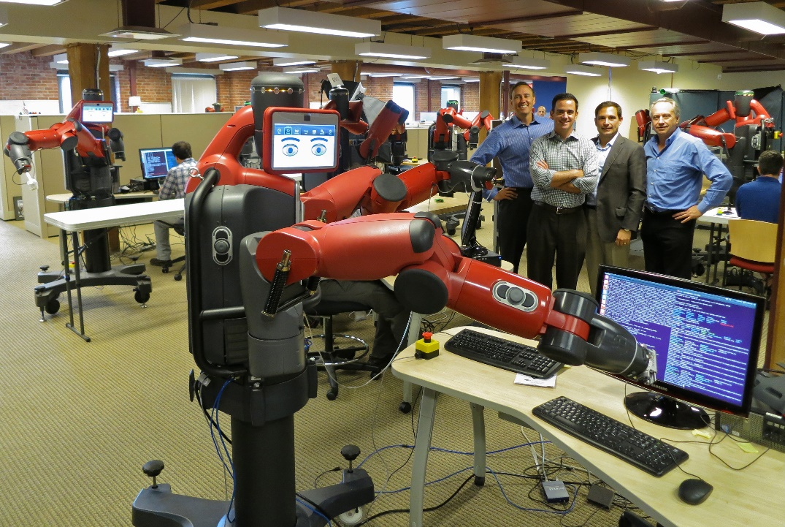
Activity 1: Reflection
True or False?
There is a common saying that in the future, robots and A.I. will replace all humans in workplaces.
We’re going to investigate this claim!

Slide 8
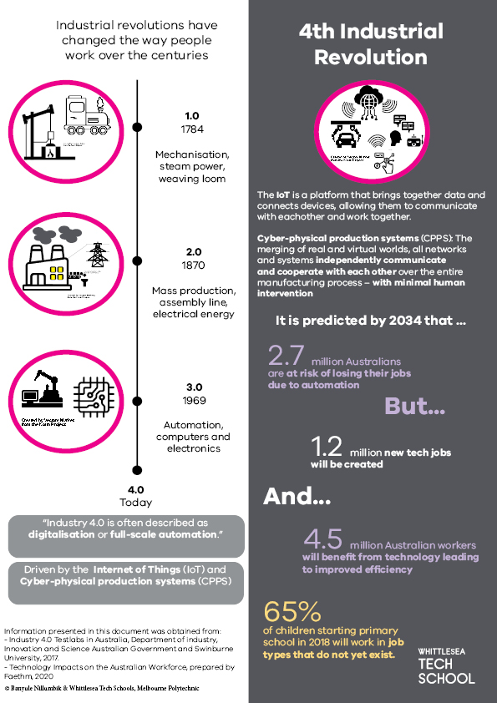
4th Industrial Revolution
We are currently undergoing a 4th industrial revolution.
What does this mean for your future?

Slide 9
By the end…
You’ll will have a better understanding of what the 4th industrial revolution (industry 4.0) is and how you can prepare for it.

Slide 10
Industry 4.0

Slide 11
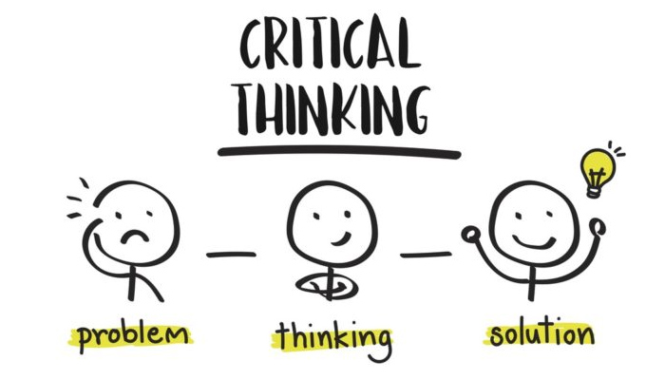
What machines and A.I. can’t do very well.

Slide 12
Activity 2
The Pen Challenge
In groups of 4 – take apart 10 pens and put the all parts on the table.
Notes:
Facilitator notes:
These short activities are to highlight the general skills students will be practicing at the tech school.
After challenge 1 – discuss what true height means – are people ordered on their true height or the height they are today? (i.e. think about the shoes you are wearing today) (practicing critical thinking skills)
After challenge 2 – discuss how people managed to form the groups without talking? What creative ways did they use? (practicing creative thinking skills)

Slide 13
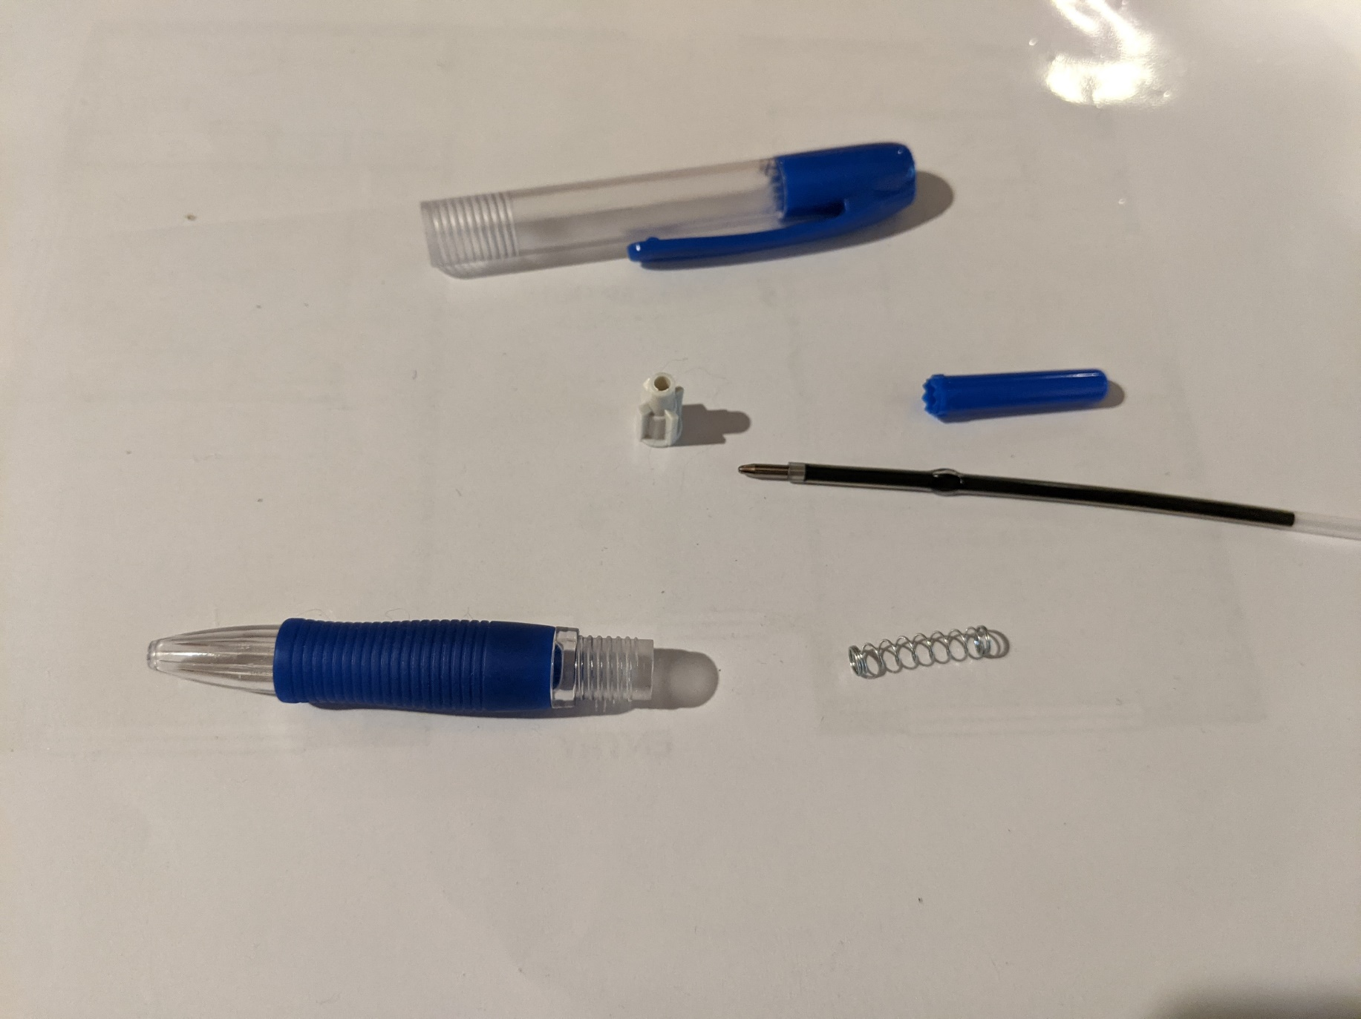

Slide 14
Activity 2
The Pen Challenge
Challenge – Try and re-assemble the 10 pens in your group as fast as you can.
As soon as your groups has finished look at your time. You have a total of 1:30 mins to do as much as you can.
Record your results on your worksheet “Pen Challenge”

Slide 15
Round 2
The Pen Challenge
You have 6 minutes to discuss in your group how you can do the task quicker.
Reset the task and get ready for round 2.
See if your group could finish more pens in round 2.

Slide 16
The Pen Challenge
Share with the class some strategies your group used to construct the pens faster.
The pen challenge is an example of a novel problem. Novel means new.
Solving new problems is something machines can’t do… Lets explore why?
https://www.youtube.com/watch?v=gWmRkYsLzB4

Slide 17
Solving novel problems
Solving new problems requires
Critical thinking: analysing data and facts to draw conclusions
Collaboration: working with others to get tasks done as well as using people skills to draw out necessary information.
Creativity: coming up with new and novel ideas or solutions.
How did you use these skills in the pen challenge? (Complete on your worksheet)

Slide 18
Check in questions
Question: What do machine need in order to learn?
Question: Why are machines bad at solving new problems?
Lots of data and examples
Data won’t exist for new problems.
They can’t create completely new ideas

Slide 19
In summary
The 4th industrial revolution is changing how we work.
A.I. and automation is useful but are not good at doing tasks they have never seen before.
This means jobs of the future will require more critical thinking, collaboration and creative skills from people.

Slide 20
Inquiry program
This subject will help develop our CCC skills
Critical thinking
Collaboration
Creative thinking
We’ll be doing inquiry to practice these skills.

Slide 21
Success Criteria
Did you achieve the following?
* I participated in class discussion around the future of work.
* I participated in class activities that helped me identify the kind of skills that are important in future jobs.
* I understand the purpose of this elective.

